Slide 1
From raw data to publication package Part 2: Publication packages, a step towards transparency, reproducibility, and reusability of data?
Willemijn Plomp, data steward at Leiden University

Slide 2
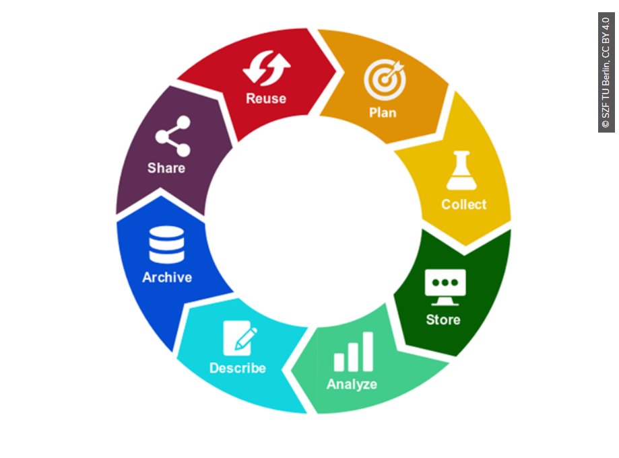

Slide 3
Overview
1. What is a publication package?
2. What is the importance of publication packages?
3. Where do we store publication packages?
4. Assignment: Searching and evaluating publication packages: How ‘FAIR’ are they?
BREAK
5. Privacy and sensitive data
6. Difficulties

Slide 4

Let me introduce myself:
Willemijn Plomp
Data steward for Psychology and Educational Studies
Leiden University
w.p.plomp@fsw.leidenuniv.nl

Slide 5
1. What is a Publication Package?
All the materials necessary to replicate the study, reproduce the results and reuse the data.
(Researchers can add a link to their publication package in their paper.)
1) Paper or manuscript
2) Materials, instructions, procedures
3) Raw data
4) Computer code for data analyses
5) Processed data
6) Data management plan
7) README file
8) Approved ethics protocol
9) Preregistration

Slide 6
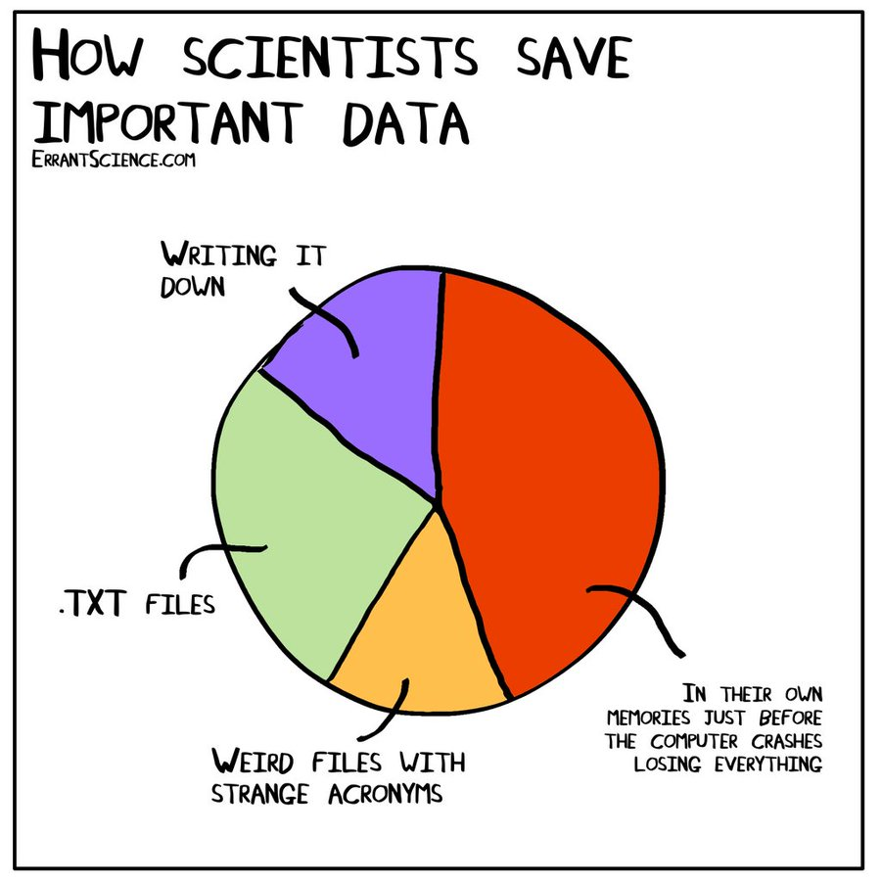

Slide 7
1. What is a publication package?
Based on:
Guideline for the archiving of academic research for Faculties of Behavioural and Social Sciences in the Netherlands (2022) https://doi.org/10.5281/zenodo.7583830
DSW (Deans of Social Sciences in the Netherlands)
"The principles of honesty, scrupulousness, transparency, independence, and
responsibility form the basis of research integrity"

Slide 8
1. What is a publication package?
Tips:
Start making your publication package during your project, not afterwards.
Ask someone in your team to check your package before sharing it.
Notes:
Inhaken op deel 1

Slide 9
2. What is the importance of publication packages?

Slide 10
2. What is the importance of publication packages?
Transparency & integrity (code of conduct)
Allows others to see your work and reproduce your results
Reusability of data and other materials
Allows combining datasets for more robust research
Prevents overburdening small, vulnerable target populations
Prevents researchers from “reinventing the wheel” when designing studies
Prevention of data loss

Slide 11
2. What is the importance of publication packages?
Combining datasets for more robust research
Replicating research
Exploring the “replication crisis”
Do we find the same results in different time periods, in different locations, etc.?
Saves time & costs
Budget cuts. Maybe this is a good opportunity to reuse more data?

Slide 12
2. What is the importance of publication packages?
Replication crisis
More replication research is needed, more collaboration, publishing null results, and being able to acknowledge errors.
However, for your career, it is mainly important to publish a lot, preferably new studies...
Notes:
HBO – meer focus op transparantie en hoe dat zou helpen tegen de replicatiecrisis
Gen H-index, geen publicatiedruk. -> benoem verschil uni/hbo data geeft meer gewicht aan je resultaten

Slide 13
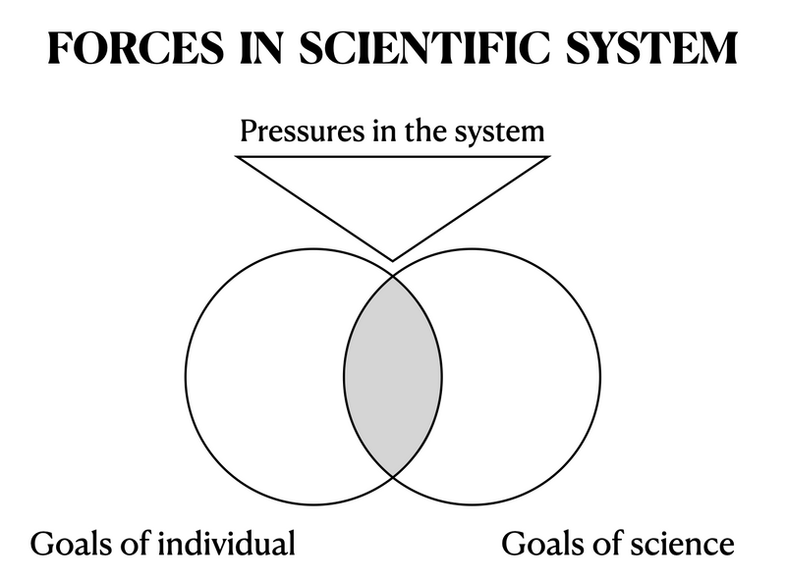
Reference: https://responsible-scholarship.pubpub.org/pub/rsp#n46ml93gftv

Slide 14
2. What is the importance of publication packages?
Transparency less fraud? (not sure about that...)
If you know that someone else can see your steps, you automatically start working more carefully. This mainly benefits yourself!
Gives more weight to your research results

Slide 15
Questions?

Slide 16
3. Where do we store publication packages?
A data repository is a storage place for researchers to store the datasets associated with their research.
Online platform to share data
Make your data citable by adding a persistent identifier (DOI)
Contribute to the findability of your data
Make your data more valuable for current and future research
Preserve your data for long-term storage
We mostly use DataverseNL.

Slide 17
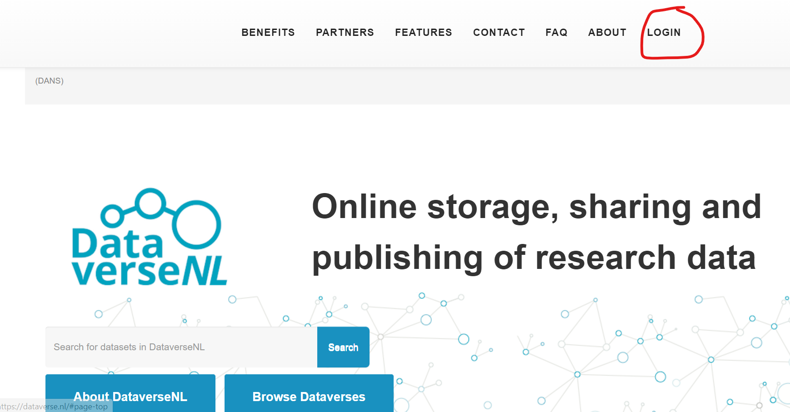
3. Where do we store publication packages?
Click on “Log in” and choose “Institutional Login”
https://dataverse.nl/

Slide 18
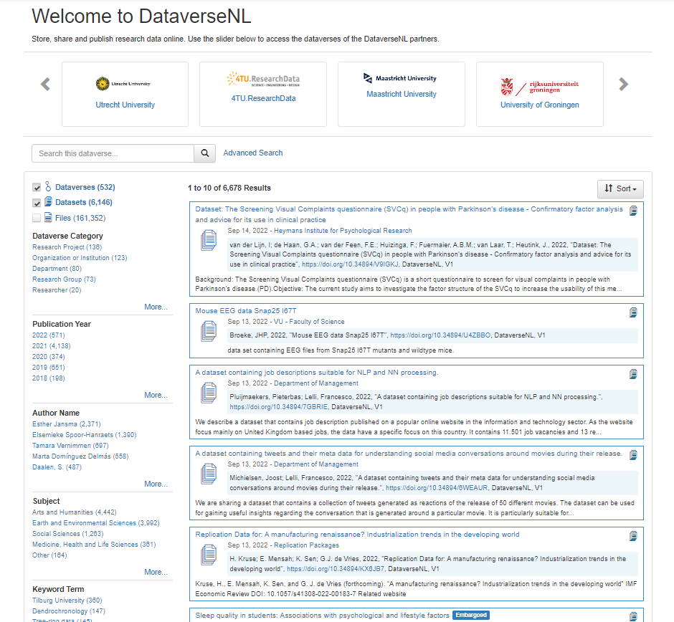
Search by:
Title
Keyword
Subject
University/Institution
Year

Slide 19
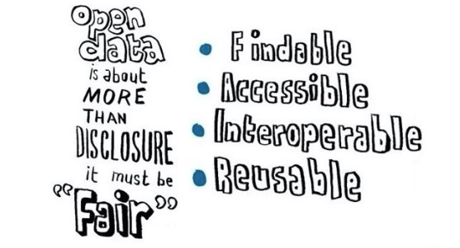
4. Exercise: How FAIR is this publication package?
Findable By both humans and machines
Include metadata that allow the discovery of interesting datasets
Accessible Stored for long term with technical access and well-defined legal conditions Open if possible
Interoperable Ready to be combined with other datasets
Reusable Ready to be used for future research

Slide 20

4. Exercise: How FAIR is this publication package?
Look up the following papers and complete the assignment on the following slide:
1. Achterberg, M., Dobbelaar, S., Boer, O.D. et al. Perceived stress as mediator for longitudinal effects of the COVID-19 lockdown on wellbeing of parents and children. Sci Rep 11, 2971 (2021). https://doi.org/10.1038/s41598-021-81720-8
2. Gaëtan Mertens, Lotte Gerritsen, Stefanie Duijndam, Elske Salemink, Iris M. Engelhard, Fear of the coronavirus (COVID-19): Predictors in an online study conducted in March 2020, Journal of Anxiety Disorders, Volume 74, 2020, 102258, ISSN 0887-6185, https://doi.org/10.1016/j.janxdis.2020.102258.

Slide 21
4. Exercise: How FAIR is this publication package?
I. For every paper, on a scale of 1-10, which score do you give the FAIRness of the data?
Findable : How easy is it to find the data?
Accessible : How easy is it to gain access to the data?
Interoperable : Does the documentation support in understanding the data?
Re-usable : Does the licence allow to reuse the data?
II. Discuss your scores in groups.

Slide 22
BREAK

Slide 23
5. Privacy and sensitive data
How can you share publication packages in a safe way?
Leave out/change sensitive or identifiable data
Access conditions – Can you simply download the data, or do you need to be granted access?
Licenses – After downloading the data, what are you allowed to do with it?
Embargo's – Can you download the data immediately?

Slide 24
5. Privacy and sensitive data
“As open as possible,
as closed as necessary”

Slide 25
Leave out/change sensitive or identifiable data
To protect your participants' privacy, don't include:
Participant's names, email addresses, etc.
Conversion key (document that links participants to their code)
Videos or photographs of participants (in most cases)
In-depth interviews that cannot be de-identified
Make the data less sensitive:
Age instead of date of birth, age categories instead of absolute age
Transcripts instead of video/audio files
Deface MRI images
If possible, remove identifiable variables

Slide 26
Access levels
Open | Everyone can download, open access
Closed | Not for download, the data is only uploaded for archiving and integrity purposes
Upon request/ limited | You can request access to the data. The original researchers may want to discuss the conditions for sharing the data, such as: Submitting a research plan, Using the data only for research or educational purposes Destroying the data after use Etc. It is likely necessary to set up a Data Sharing Agreement before the data can be shared.
Notes:
Hoe gevoelig & wat is er beloofd in de informed consent?

Slide 27
5. Privacy and Sensitive data
Other reasons your data can be sensitive:
Company secrets
Knowledge security
=Preventing unwanted transfer of sensitive knowledge and technology
E.g., nuclear secrets to Iran
E.g., can your civilian research also be used for military purposes? (dual use)
?

Slide 28
6. Difficulties
Checking and uploading publication packages takes me a lot of time, especially if it requires emailing back and forth with researchers.
Researchers do not have time.
Difficult to get on overview of how often researchers are (not) making a publication package when they ought to.

Slide 29
6. Difficulties
Scary – Mistakes can be found, data breaches can occur.
Quality of publication packages varies.
e.g., low quality meta-data: Unclear variable names or labels. No codebook.
Qualitative data are difficult to share.
Reusing data can be challenging:

Slide 30
6. Difficulties
Reusing data:
There is inevitably a loss of information when data are taken out of their context.
Trust: Can you be sure that the data are reliable?
Technical difficulties:
File formats that are unknown, software-specific, or outdated.
Corrupted files
Broken links.
References: Peter Verhaar: Data Reuse Day
Koellinger, P.. (2023): FAIR Dat. https://dpid.org/247/v3/root/Presentation.pdf

Slide 31
6. Difficulties
Reusing data:
Copyright issues or incompatible licenses
“Data available upon request”
No response from the authors.
Authors can't find their data or don't have access anymore
Wrong version of the data.
Legal agreements required before sharing
References: Peter Verhaar: Data Reuse Day
Koellinger, P.. (2023): FAIR Dat. https://dpid.org/247/v3/root/Presentation.pdf

Slide 32
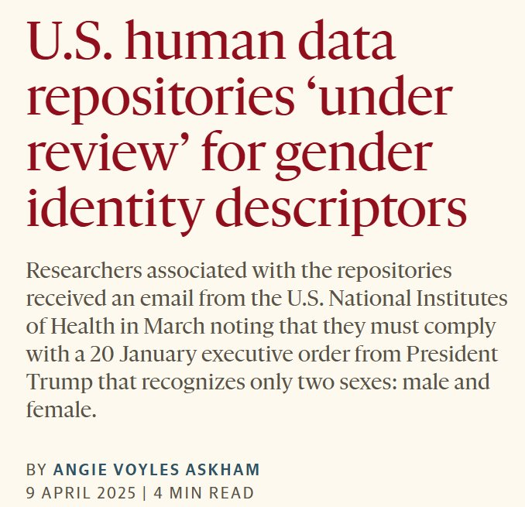
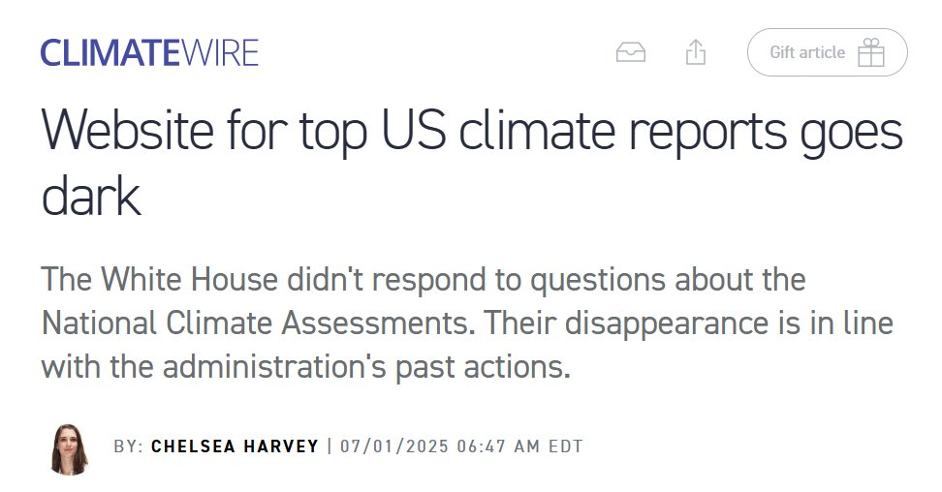
6. Difficulties
Are data still safe in data repositories?
Can we trust that all shared data are findable and unchanged?

Slide 33
6. Difficulties
A lot to improve!
But hopefully publication packages are a step in the right direction towards transparent and replicable research and data reuse.

Slide 34
Conclusions
Goal: To organize your data throughout the entire research process.
Key messages: -Start organizing in the beginning of your research.
-Keep in mind: Without documentation, you have nothing
-Archiving/sharing your data contributes to a culture of transparency and collaboration

Slide 35
Conclusions
What is the most important takeaway for you from todays workshop?
How will you implement this in your work?

Slide 36
Any questions?

